Slide 1

Survey_Optimization_SS.R: Conduct single-species stratified survey optimization
Understand potential tradeoffs of including multiple species in a stratified survey optimization
Gauge the upper constraint of how well a species’ precision can be improved by stratification and optimal effort allocation
Provide a constraint for the multispecies version of the optimization
Notes:
The goal of this optimization is to conduct a single-species stratified survey optimization. While these solutions don’t have much application in practice, these solutions can give us some important insight in our survey optimizations.

Slide 2
Survey_Optimization_SS.R: Conduct single-species stratified survey optimization
Understand potential tradeoffs of including multiple species in a stratified survey optimization
Gauge the upper constraint of how well a species’ precision can be improved by stratification and optimal effort allocation
Provide a constraint for the multispecies version of the optimization
Notes:
First, doing the optimization by species can help us understand interspecies tradeoffs when doing a multispecies survey optimization. For example, designing a good survey for one species might benefit other co-occurring species but may degrade the quality of survey estimates for other non-overlapping species.

Slide 3
Survey_Optimization_SS.R: Conduct single-species stratified survey optimization
Understand potential tradeoffs of including multiple species in a stratified survey optimization
Gauge the upper constraint of how well a species’ precision can be improved by stratification and optimal effort allocation
Provide a constraint for the multispecies version of the optimization
Notes:
Further, broadly distributed species may not benefit from stratification as much as narrowly distributed species, something that we can directly evaluate from this analysis.

Slide 4
Survey_Optimization_SS.R: Conduct single-species stratified survey optimization
Understand potential tradeoffs of including multiple species in a stratified survey optimization
Gauge the upper constraint of how well a species’ precision can be improved by stratification and optimal effort allocation
Provide a constraint for the multispecies version of the optimization
Notes:
Lastly, we will use these optimal CVs as additional constraints when we transition to the the multispecies optimization.

Slide 5
Goal: Evaluate Optimal CV for a given level of survey effort
Three levels of effort corresponding to boats
1 boat: 292 stations
2 boats: 550 stations
3 boats: 825 stations
Optimization searches for a stratification and an allocation of stations across strata that minimizes total sample size for a prespecified CV
Minimize total survey effort given a level of CV
In order to achieve our goal, we need to instead minimize CV given a level of survey effort
Notes:
The goal of our optimization is to evaluate the optimal (or minimal) CV for a given level of survey effort. For our purposes, we are interested in three levels of total survey effort corresponding to the number of boats allocated for a survey, so 292, 550, or 825 stations for one, two, and three boats, respectively. The genetic algorithm searches for the stratification and the allocation of stations across strata that minimizes the total sample size for a given CV. So put simply, it minimizes total survey effort given a level of CV. However, this does not directly attack our goal, instead we need to solve the converse; that is to minimize CV given a level of survey effort. And the way we do this while playing within the setup of the optimization is to tune that given, user-inputted CV to match the levels of total survey effort we are interested in.

Slide 6
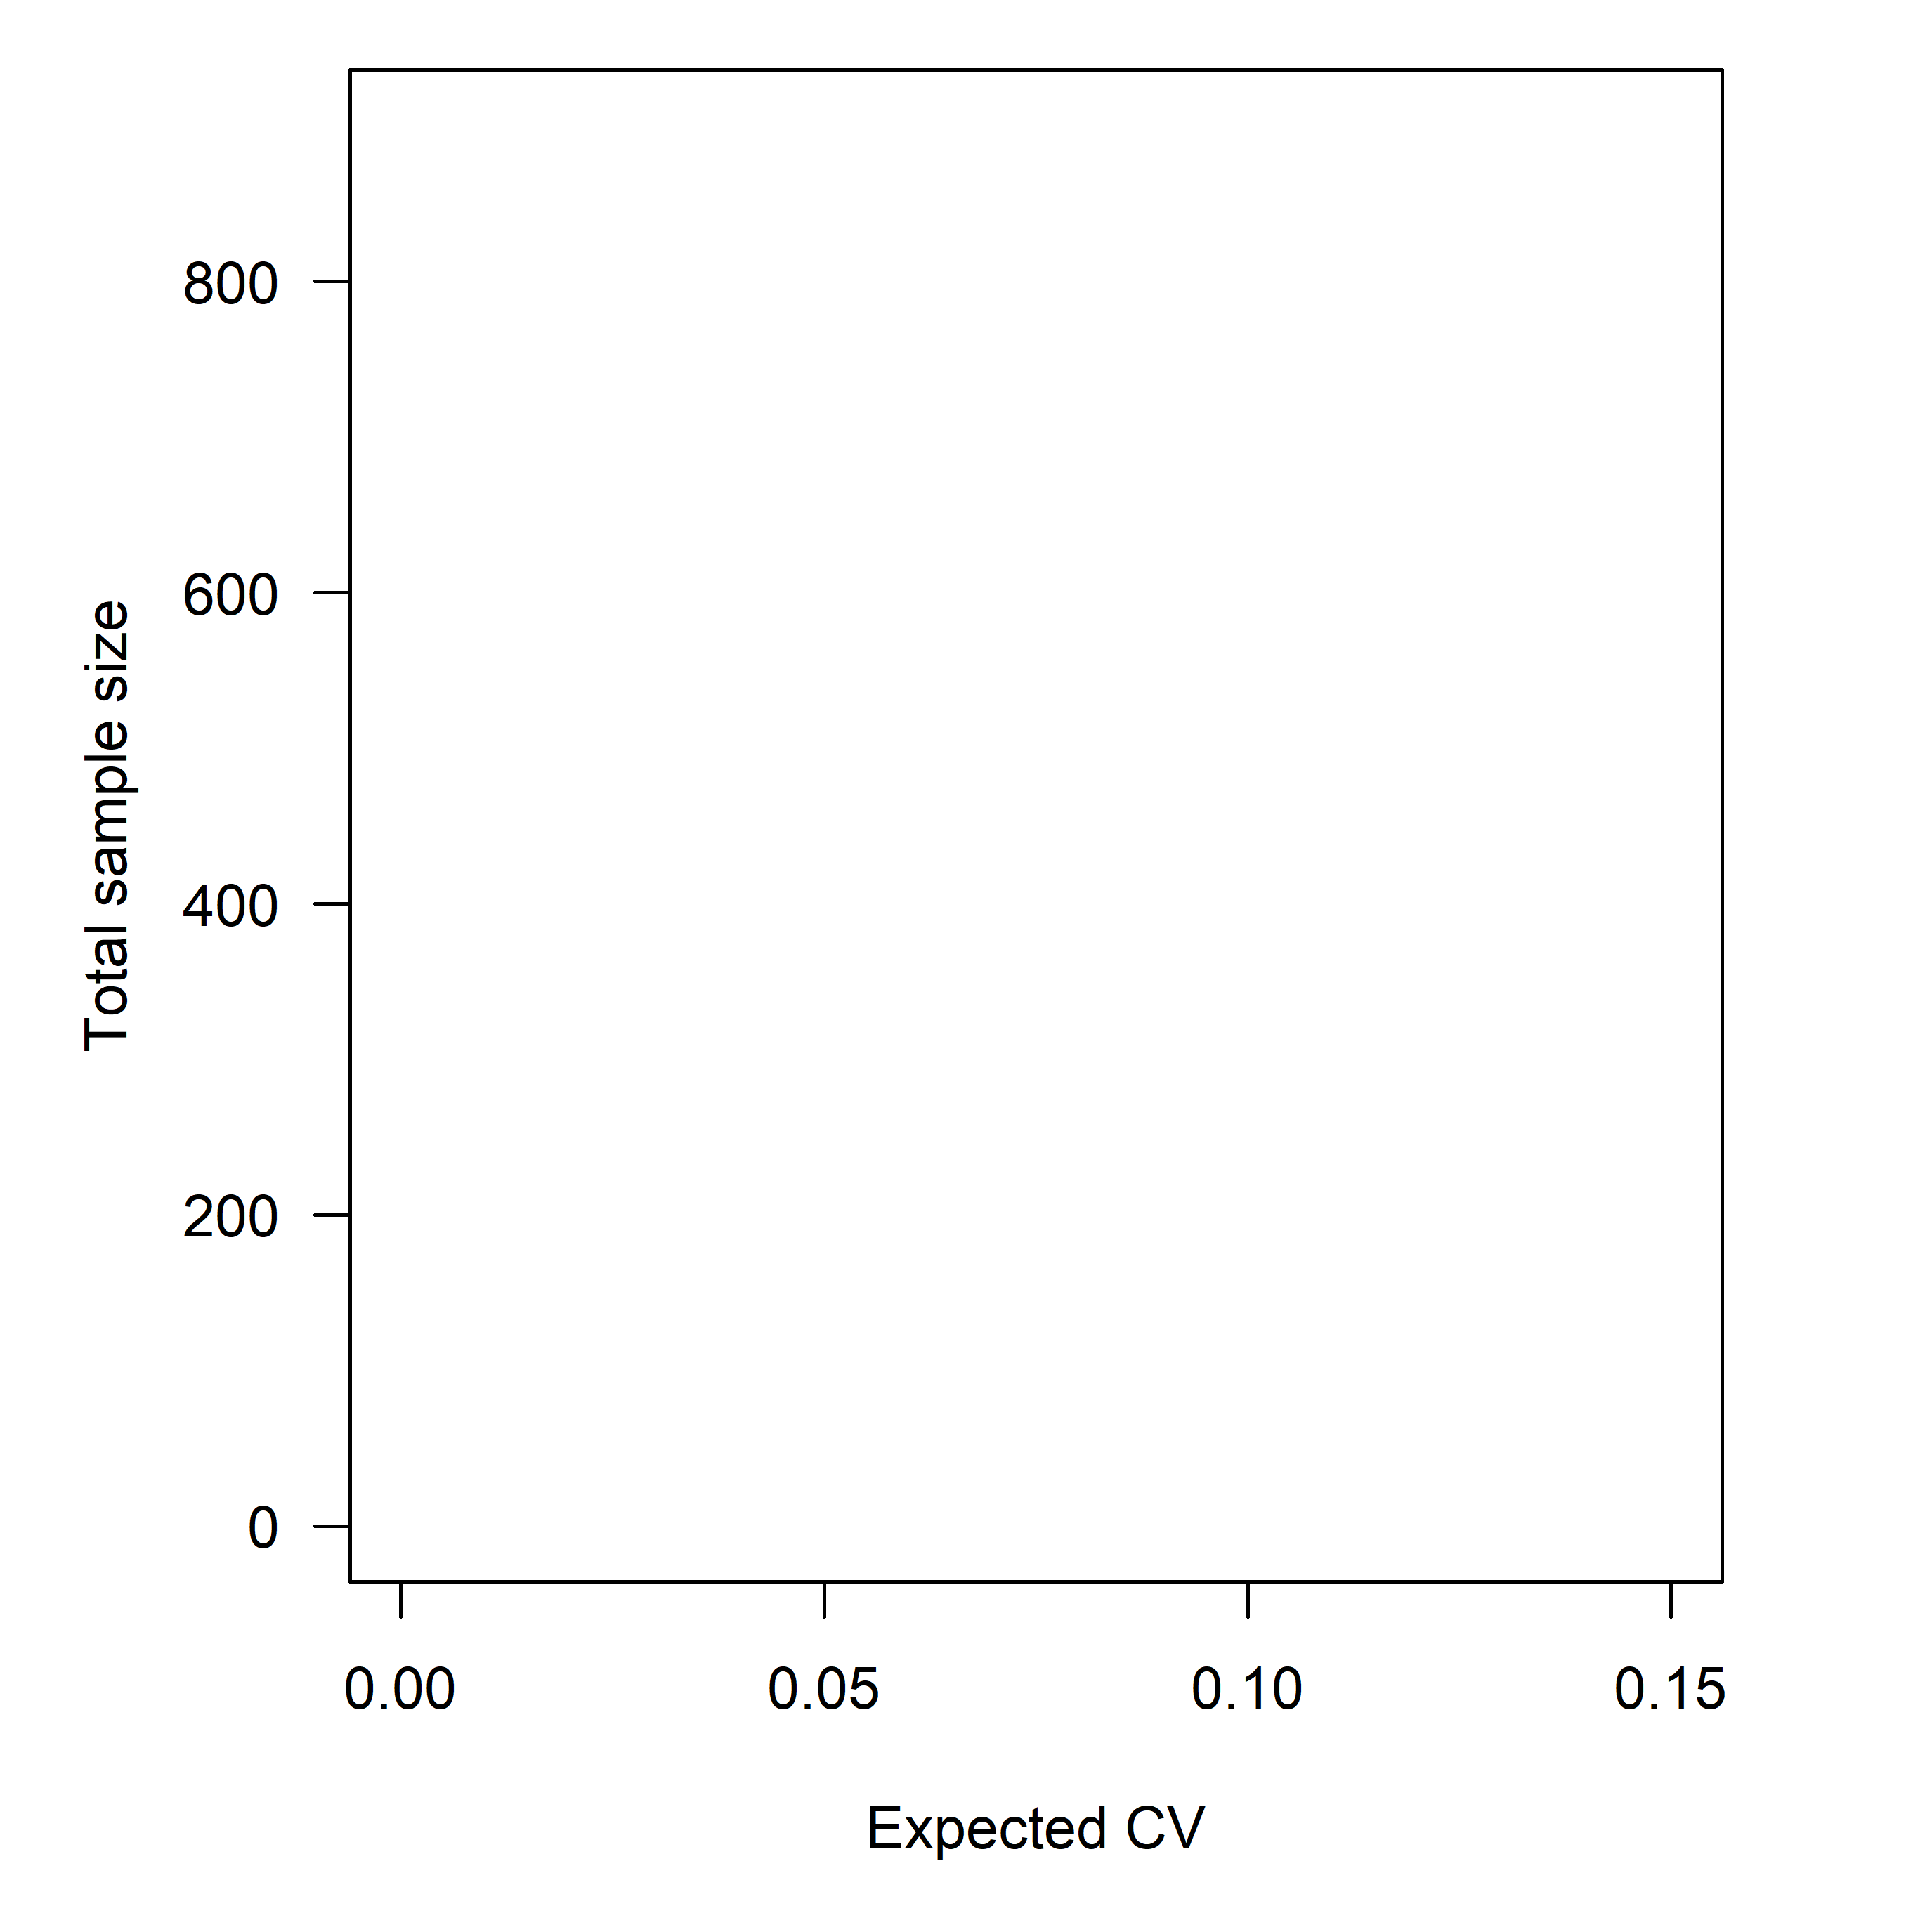
Initiate optimization at a starting CV input
Calculate the CV of a simple random survey with 292 stations
Conduct optimization, save result outputs including sample size
Reduce the CV input by a small rate (1 -> 20%)
Conduct optimization again
Conduct until optimal sample size passes 292, 550, and 825 stations
Notes:
The way we do this is by first starting at some user-defined CV constraint. To make it less arbitrary, we chose the expected CV that would result from a simple random survey with 292 stations. This is practical because we expect stratification to produce a lower CV than SRS for a given sample size.

Slide 7
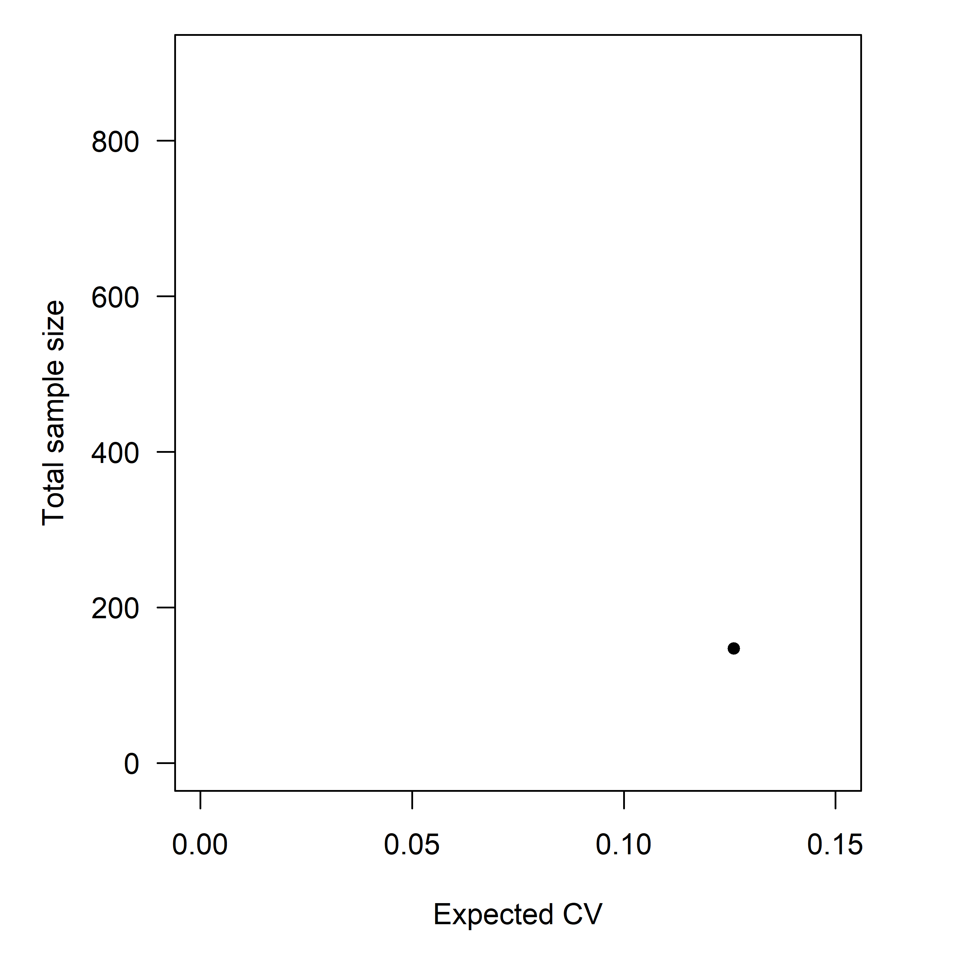
Result Outputs
Initiate optimization at a starting CV input
Calculate the CV of a simple random survey with 280 samples
Conduct optimization, save result outputs including sample size
Reduce the CV input by a small rate (1 -> 20%)
Conduct optimization again
Conduct until optimal sample size passes 292, 550, and 825 stations
Notes:
We then conduct the optimization, save the result outputs, and on this plot, for a CV of roughly 0.13, the optimized stratified survey produced a minimal total survey effort of about 190 stations, instead of 292 stations if under a simple random survey design.

Slide 8

Result Outputs
Initiate optimization at a starting CV input
Calculate the CV of a simple random survey with 280 samples
Conduct optimization, save result outputs including sample size
Reduce the CV input by a small rate (1 -> 20%)
Conduct optimization again
Conduct until optimal sample size passes 292, 550, and 825 stations
Notes:
We then reduce that CV by a small rate (denoted by the vertical line) and use that as the new CV constraint.

Slide 9
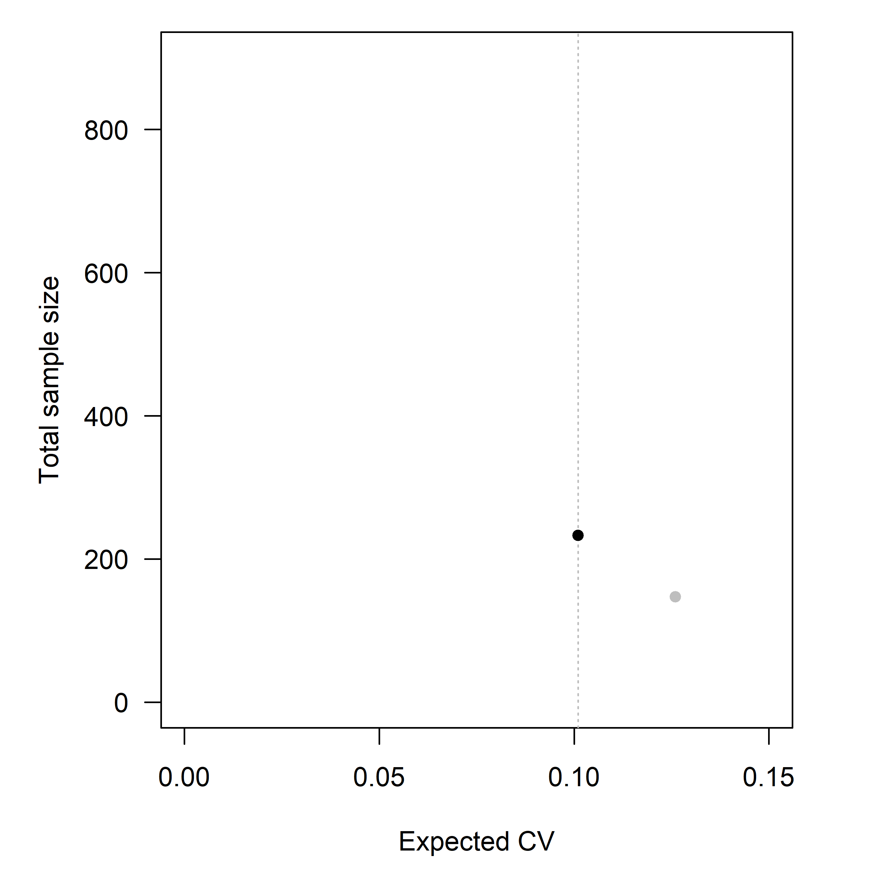
Result Outputs
Initiate optimization at a starting CV input
Calculate the CV of a simple random survey with 280 samples
Conduct optimization, save result outputs including sample size
Reduce the CV input by a small rate (1 -> 20%)
Conduct optimization again
Conduct until optimal sample size passes 292, 550, and 825 stations
Notes:
We conduct the optimization again with the reduced CV constraint and get a minimal total survey effort that is slightly higher. We should expect this because more precise (i.e., lower CV) designs require more stations.

Slide 10
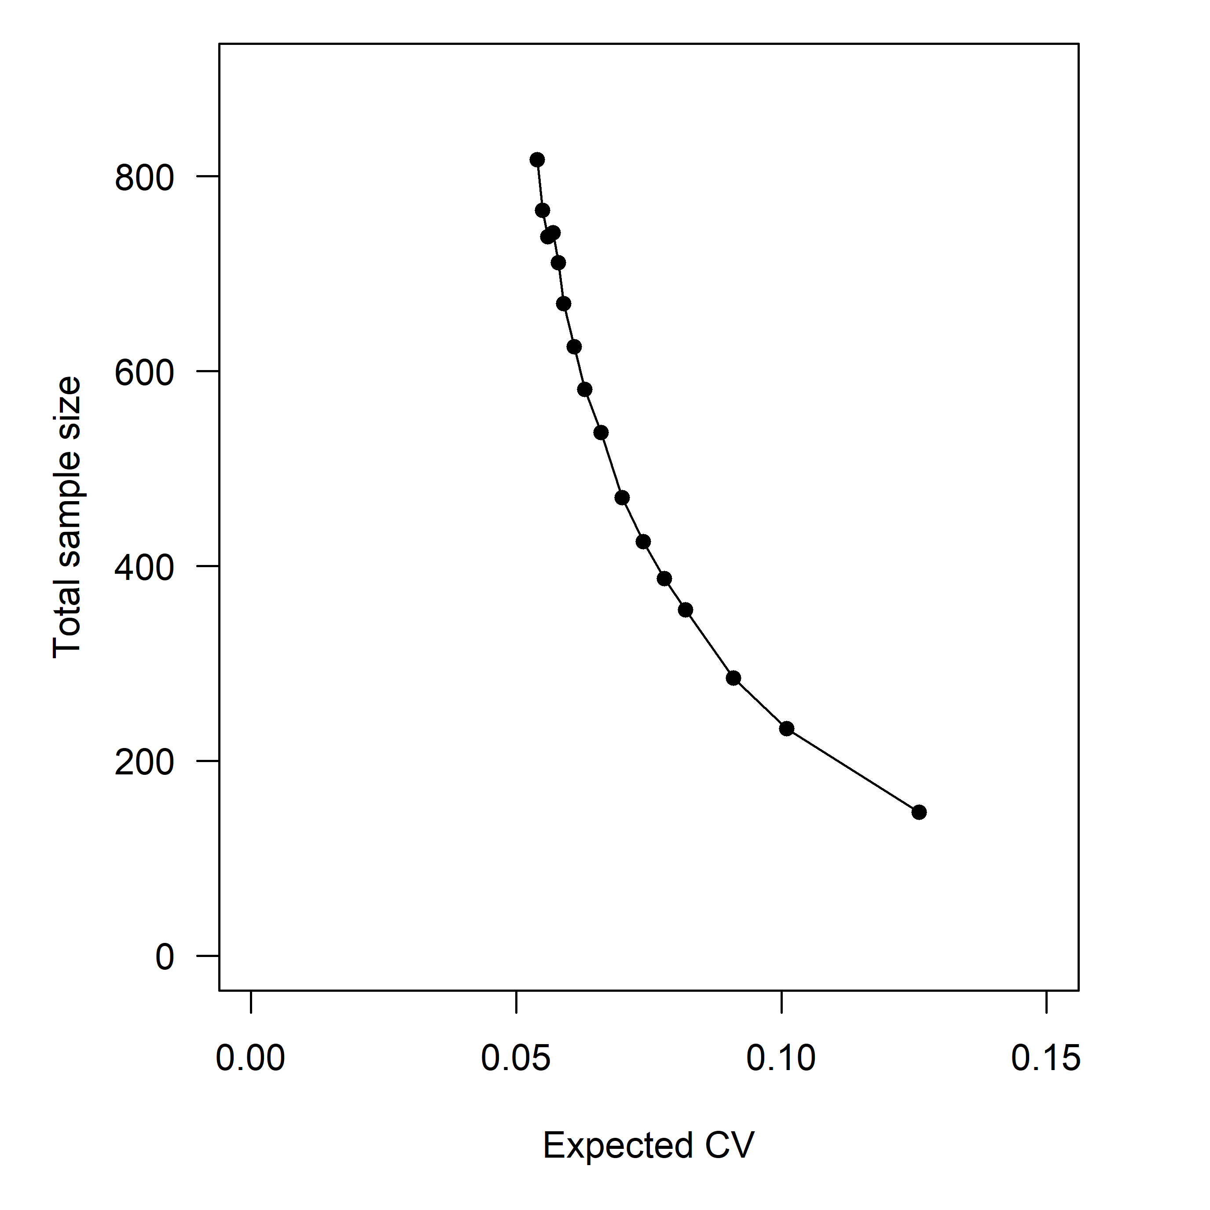
Result Outputs
Initiate optimization at a starting CV input
Calculate the CV of a simple random survey with 280 samples
Conduct optimization, save result outputs including sample size
Reduce the CV input by a small rate (1 -> 20%)
Conduct optimization again
Conduct until optimal sample size passes 292, 550, and 825 stations
Notes:
We iterate this process and by doing so the optimization passes the sample sizes we’re interested in.

Slide 11
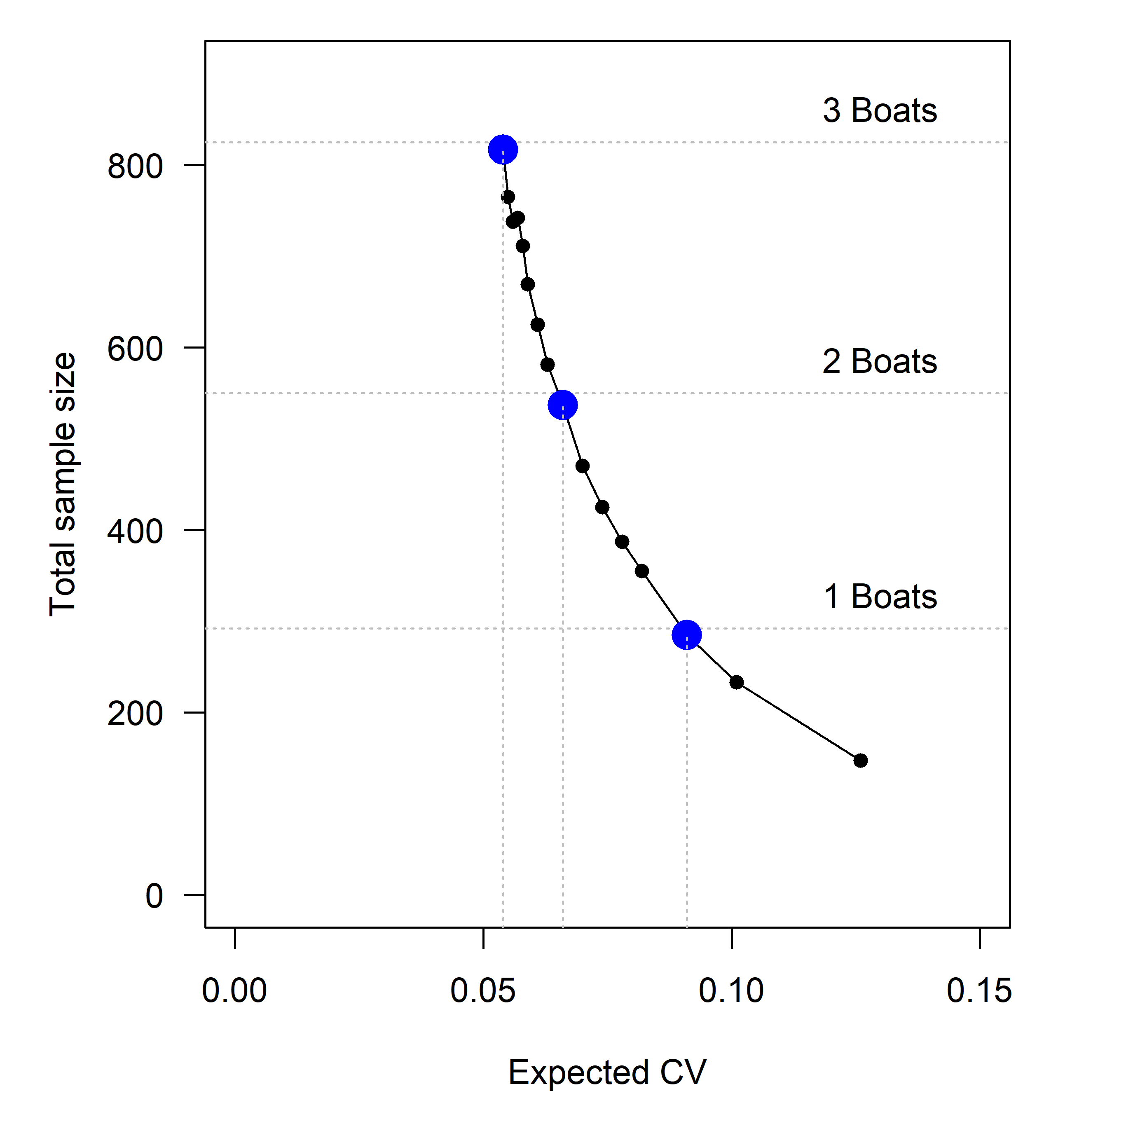
Result Outputs
Initiate optimization at a starting CV input
Calculate the CV of a simple random survey with 280 samples
Conduct optimization, save result outputs including sample size
Reduce the CV input by a small rate (1 -> 20%)
Conduct optimization again
Conduct until optimal sample size passes 292, 550, and 825 stations
Notes:
Highlighting the 1, 2, and 3, boat levels of survey effort, we can query the solutions that are closest to those total survey efforts, as shown by the solutions in blue.

Slide 12
~analysis_scripts/
Extrapolation_depths.RData
Survey_Optimization_SS.R
optimization_data.RData
~data/
knitting_runs_SS.R
Pacific cod
. . .
arrowtooth flounder
sablefish
optimization_knitted_results.RData
~results/full_domain/Single_Species_Optimization/
Single-Species Survey optimization

